Slide 1

2310030378-V.RAKESH REDDY
2310030382-P.JAYASIMHA REDDY
2310030385-N.PARTHA SARATHI REDDY
2310030387-K.AKHIL REDDY
2310030389-Y.SAKETH REDDY

Slide 2
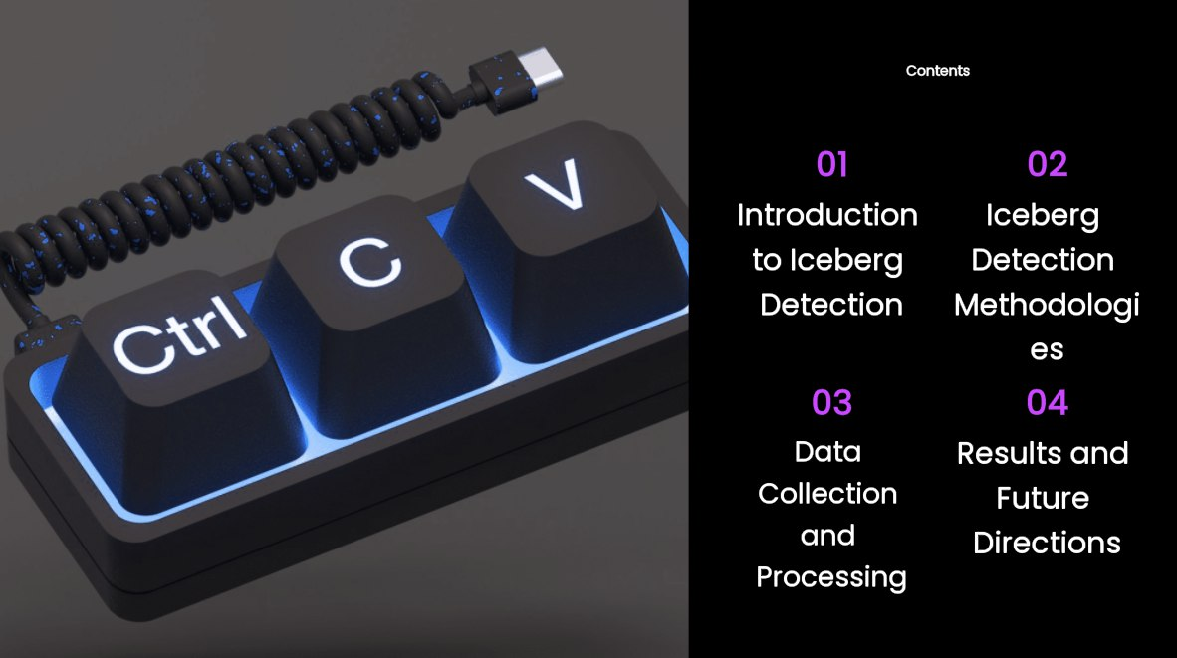

Slide 3


Slide 4
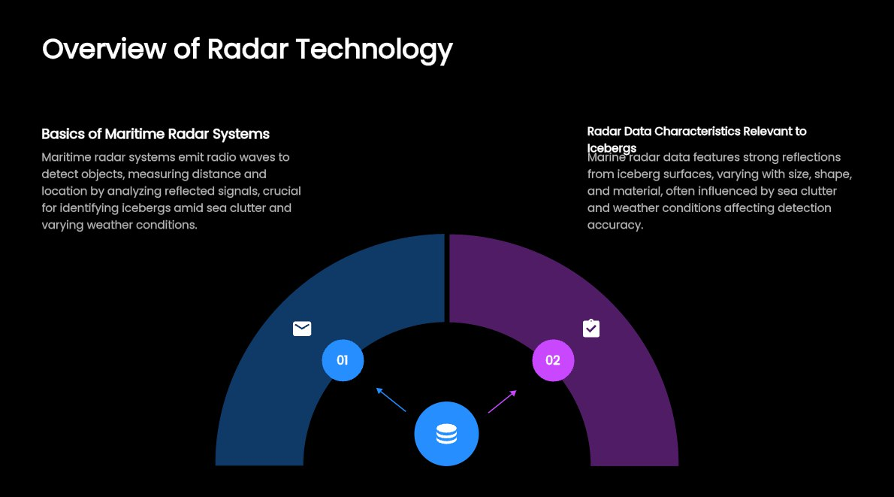

Slide 5
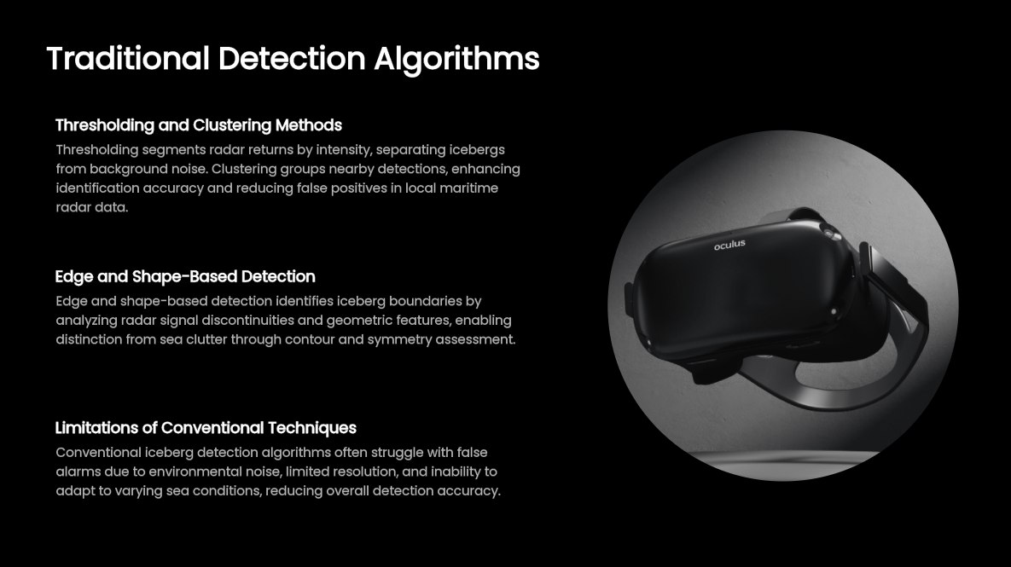

Slide 6
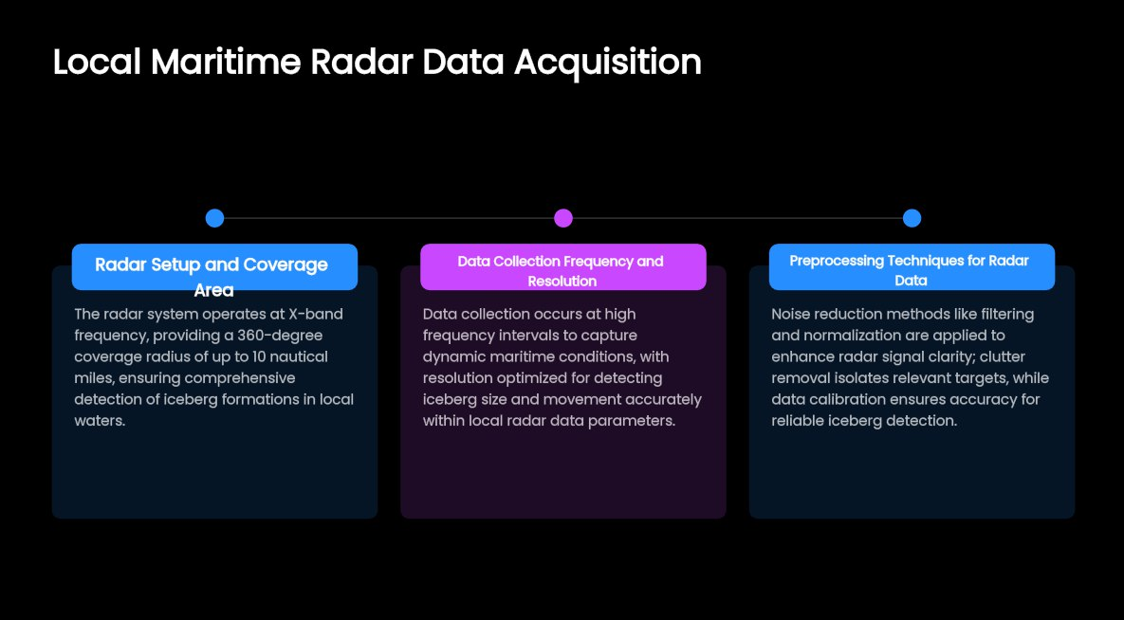

Slide 7
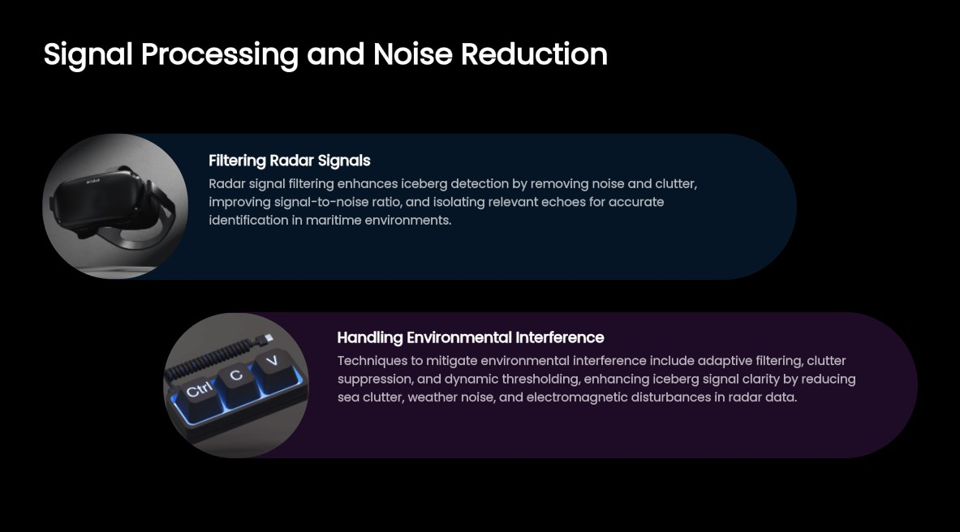

Slide 8
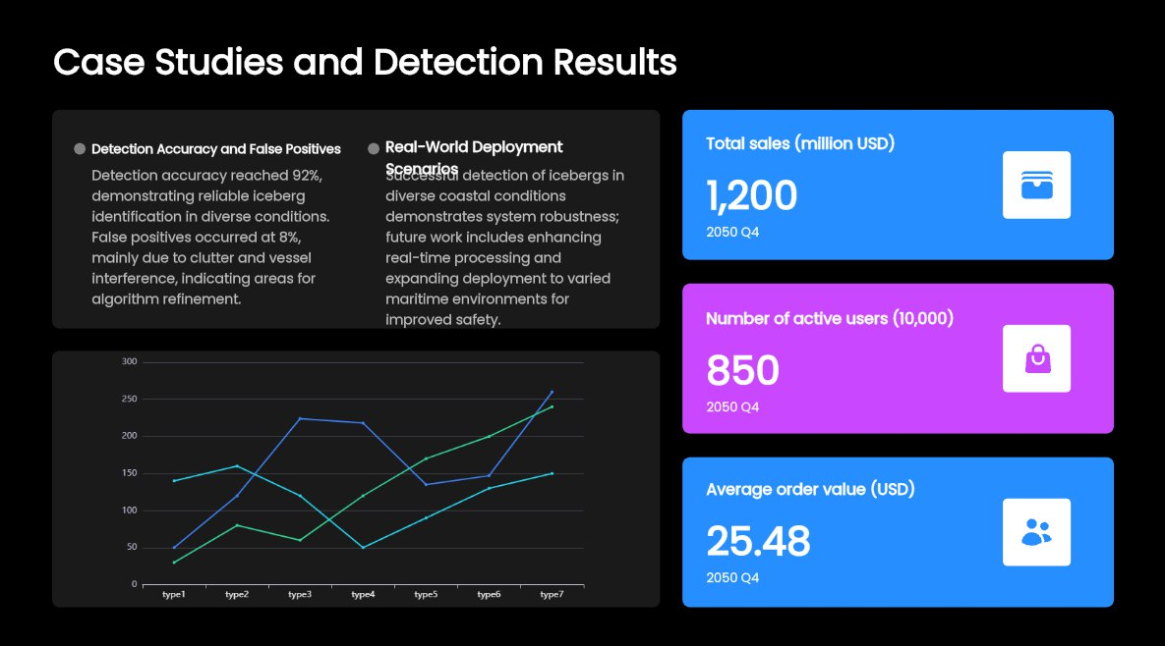

Slide 9
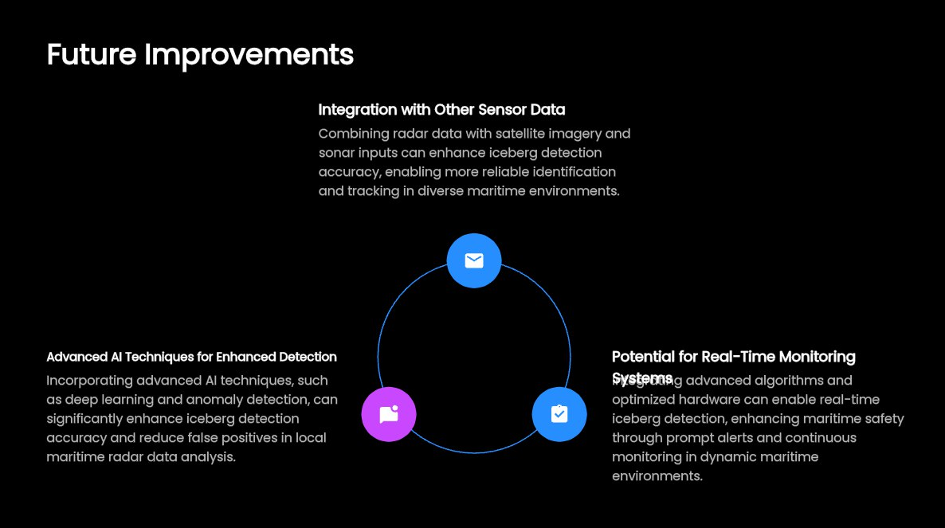

Slide 10


